Slide 1
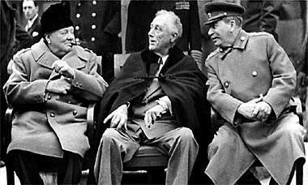
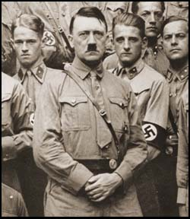
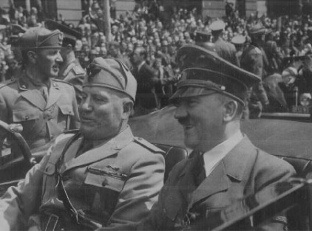
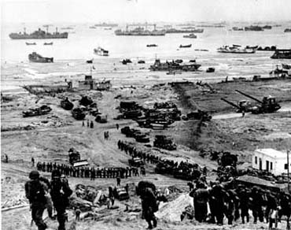
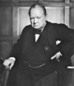
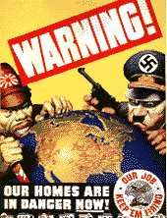
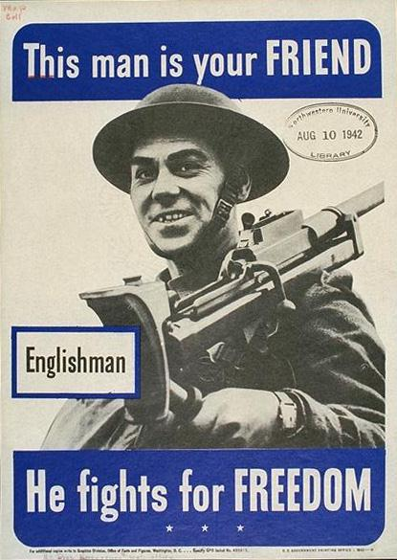
Origins of WW II

Slide 2
Hitler’s Foreign Policy
Hoped to achieve
Destroy Versailles settlement
Building up army
Recovering lost territory
Bringing all Germans inside the Reich

Slide 3
Wants Lebensraum
Food and living space for excess of German population

Slide 4
A.J.P. Taylor claims that Hitler never intended a major war, only a limited war against Poland.

Slide 5
German successes
Withdrew Germany from World Disarmament Conference and League of Nations
On the grounds that France would not agree to Germany having equal arms

Slide 6
Jan. 1934 signs 10 year non-aggression pact with the Poles
Britain views this as further evidence of peaceful intent
Ruins the Little Entente
France, Poland, Czechoslovakia, Romania, Yugoslavia
Improves relationship between France and Soviets

Slide 7
July 1934 suffers setback to Anschluss
Austrian Nazis stage revolt and murder Chancellor Englebert Dollfuss (supported by Mussolini)
Mussolini moves Italian troops to the border and revolt collapses

Slide 8
Hitler is not strong enough to force the issue
Jan. 1935 Saar was returned to Germany
Plebiscite placed 90% of people in favor
Hitler announces that causes for grievances with France removed

Slide 9
March 1935 Reintroduction of conscription
1st successful violation of Versailles Treaty
Announces military buildup to 36 divisions (army)
Condemned by Stresa Front (informal alliance of Britain, France and Italy)

Slide 10
June 1935 Anglo-German Naval Agreement
Britain agrees to limit Germany to 35% of British Navy
Without consulting allies Britain had condoned German rearmament

Slide 11
March 1936 - Encouraged by successes Hitler took the risk of sending troops into the demilitarized zone in the Rhineland
Breach of both Versailles and Locarno
Troops told to withdraw at the first sign of resistance, none occurred

Slide 12
1936 Rome-Berlin Axis signed with Italy and Anti-Comintern Pact signed with Japan (Italy will join this in 1937)
German and Italian military experience in Spanish Civil War

Slide 13
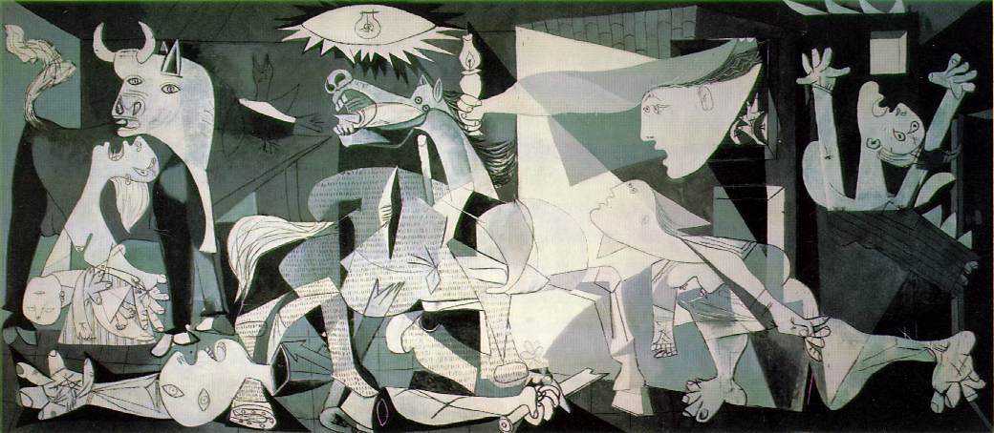
Guernica

Slide 14
March 1938 Anschluss
Austrian Nazis stage huge demonstrations
Chancellor Schuschnigg announces a plebiscite over Austrian independence
Hitler moved before the vote and German troops took control of Austria

Slide 15
British and French protest Anschluss but take no action
Showed the weakness of Britain and France
Deals severe blow to Czechoslovakia as Hitler now begins campaign to control the Sudetenland

Slide 16
Appeasement
Avoiding war with aggressive powers by giving in to their demands (provided they were not too unreasonable)
Two distinct phases

Slide 17
Phase 1 Mid 1920s to 1937
Vague feeling that war must be avoided at all costs
Britain and France accept various acts of aggression and violations of Versailles

Slide 18
Phase 2 1937 – 1939
When Neville Chamberlain becomes Prime Minister he gives appeasement new life
He hoped to find out what Hitler wanted and show him that reasonable claims can be gained by negotiation and not force

Slide 19
Justification for Appeasement
It was thought essential to avoid war (Britain had a strongly pacifistic public)
Many felt Germany and Italy had justifiable grievances

Slide 20
With League of Nations helpless Chamberlain believed personal contact between leaders was only way to settle disputes
Economic cooperation between Britain and Germany would be good for both

Slide 21
Fear of Communist Russia was great, especially among British Conservatives (Nazism could be a buffer against western movement of communism)
Many admired Hitler’s drive and achivements

Slide 22
Underlying position was that Britain ought not to take any action in case it led to full scale war (which Britain was not prepared for)

Slide 23
What role did appeasement play in international affairs 1933-1939?

Slide 24
Profound effect on way international relations developed
Many historians believe it convinced Hitler of complacency and weakness of Britain and France
Mainly a British policy, French are not always in agreement

Slide 25
Six samples of Appeasement at work
No action take to check obvious German rearmament
The Anglo-German Naval Agreement
Half-hearted British action against the Italian invasion of Abyssinia

Slide 26
The French did not mobilize their troops when the Germans remilitarized the Rhineland
Neither Britain nor France intervened in the Spanish Civil War
Britain and France strongly protested Anschluss but inaction encouraged Hitler to make demands on Czechoslovakia

Slide 27
Hitler wants to destroy Czechoslovakia as part of Lebensraum
His excuse was that the Sudeten Germans were being discriminated against (3.5 million)

Slide 28
Nazis organize huge protests
Czech President Benes feared disturbances would be used as an excuse by Hitler to intervene
Chamberlain and Daladier pressured Czechs to make concessions

Slide 29
Munich Conference 1938
Mussolini hosted
Hitler, Chamberlain and Daladier
Mussolini presents plan (written by German Foreign office)

Slide 30
Germany receives the Sudetenland
Sovereignty for rest of Czechoslovakia is guaranteed by the four nations
Czechs told if they resist they would receive no help from British or French

Slide 31
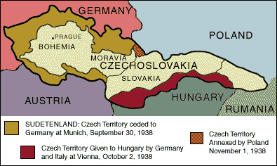

Slide 32
Chamberlain upon return to Britain
“I believe it is peace for our time”
Churchill response
“a total and unmitigated defeat”

Slide 33
March 1939 Hitler takes the rest of Czechoslovakia
With heavy industry and fortifications lost Czechs were in chaos
Hitler pressures Czech president into asking for German help “to restore order”

Slide 34
Poland
April 1939 Hitler demands the return of Danzig and the Polish Corridor
Not really an unrealistic demand but after Czechoslovakia no one believed this was all he wanted

Slide 35
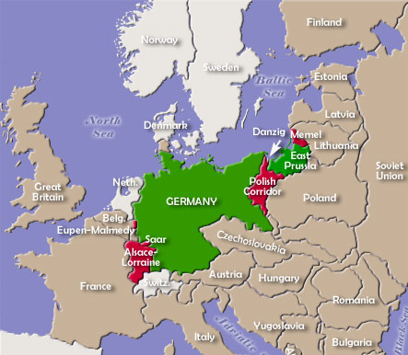

Slide 36
With British support Poles refuse
Only way British support would be effective is with an alliance with Soviets
Hitler acts first

Slide 37
Nazi-Soviet Non-Agression Pact (Molotov – von Ribbontrop Pact)
Divide Poland between the two nations
With Soviets neutral Hitler did not believe Britain or France would intervene

Slide 38
September 1, 1939 Germany invades Poland (blitzkrieg style warfare)
Chamberlain pushed to issue ultimatum
Britain declares war Sept. 3

Slide 39
Who or what was to blame for war?
Versailles Treaty for harsh treatment of Germans
League of Nations and failure of collective security
The world economic crisis

Slide 40
Was Hitler to blame?
Martin Gilbert
Hitler wanted to remove stigma of WWI loss “the only antidote to defeat in one war is victory in the next”

Slide 41
Hugh Trevor-Roper and others believe Hitler planned a major war from the beginning
To destroy Russia
Evidence for this is taken from Mein Kampf and the Hossbach Memorandum
If true appeasement is not to blame and the German people would not be at fault

Slide 42
Were Appeasers to blame?
Some Historians argue Britain and France should have taken a firm line with Hitler
Alan Bullock “success and the absence of resistance tempted Hitler to reach out further, to take bigger risks”

Slide 43
Chamberlains critics argue he stood firm for the wrong cause
It would have been better to stand firm with Czechoslovakia than Poland who was more difficult to defend and weaker militarily

Slide 44
Did Hitler intend a major war?
A.J.P. Taylor: Hitler did not intend to cause a major war and expected at most a short war with Poland
Taylor was seen as trying to “whitewash” Hitler by his critics
Not accepted by most historians today

Slide 45
Did Soviets make war inevitable?
Argued that by signing the non-aggression pact it allowed Germany to begin war
Russian historians justify pact on the grounds it gave USSR time to establish its defenses

